Slide 1
Letters

Slide 2
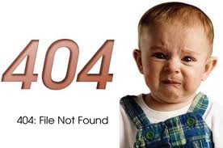


Questions:
What is the small letter of: D :
b
b) f
c) d

Slide 3

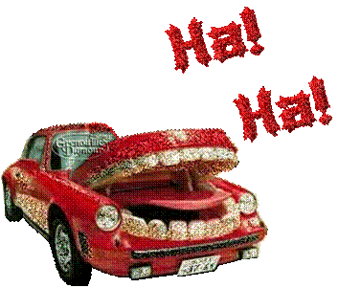

2) The capital letter of i:
a) E
b) I
c) Y

Slide 4

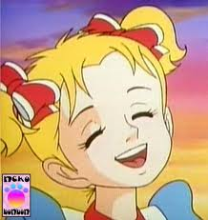
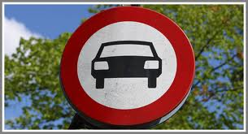
3) The capital letter of u :
a) Y
b) U
c) W

Slide 5
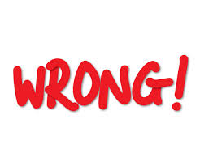

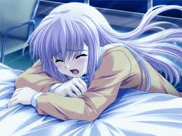
4) The small letter of B:
a) b
b) d
c) a

Slide 6
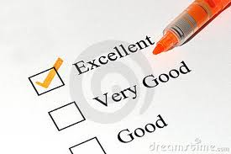
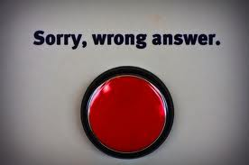
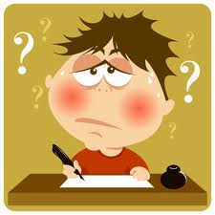
5) Continue:
---, d, e, f ,g
a) b
b) c
c) e

Slide 7



6) Continue:
m, n , o , p , -----
a) p
b) q
c) r

Slide 8
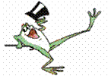
7) Continue: h , I , -----, k
1. j
2. g
3. L

Slide 9

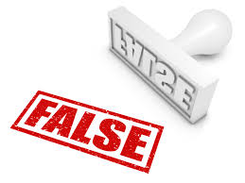
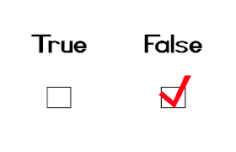
Fill in the missing: c___ t
3. i
2. u
1. a

Slide 10



Fill in the missing: d___g
1. a
2. u
3. o

Slide 11



Fill in the missing:
D____d
1. e
2. a
3. i

Slide 12

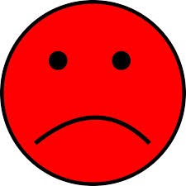
What is the meaning of:
Happy
1. فرحان
2. حزين
3. تعبان

Slide 13

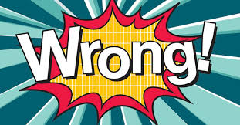
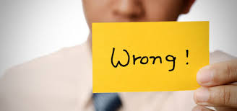
What is the meaning of :
Tired
1. تعبان
2. جائع
3. عطشان

Slide 14
Activity

Slide 15
homework

